Slide 1
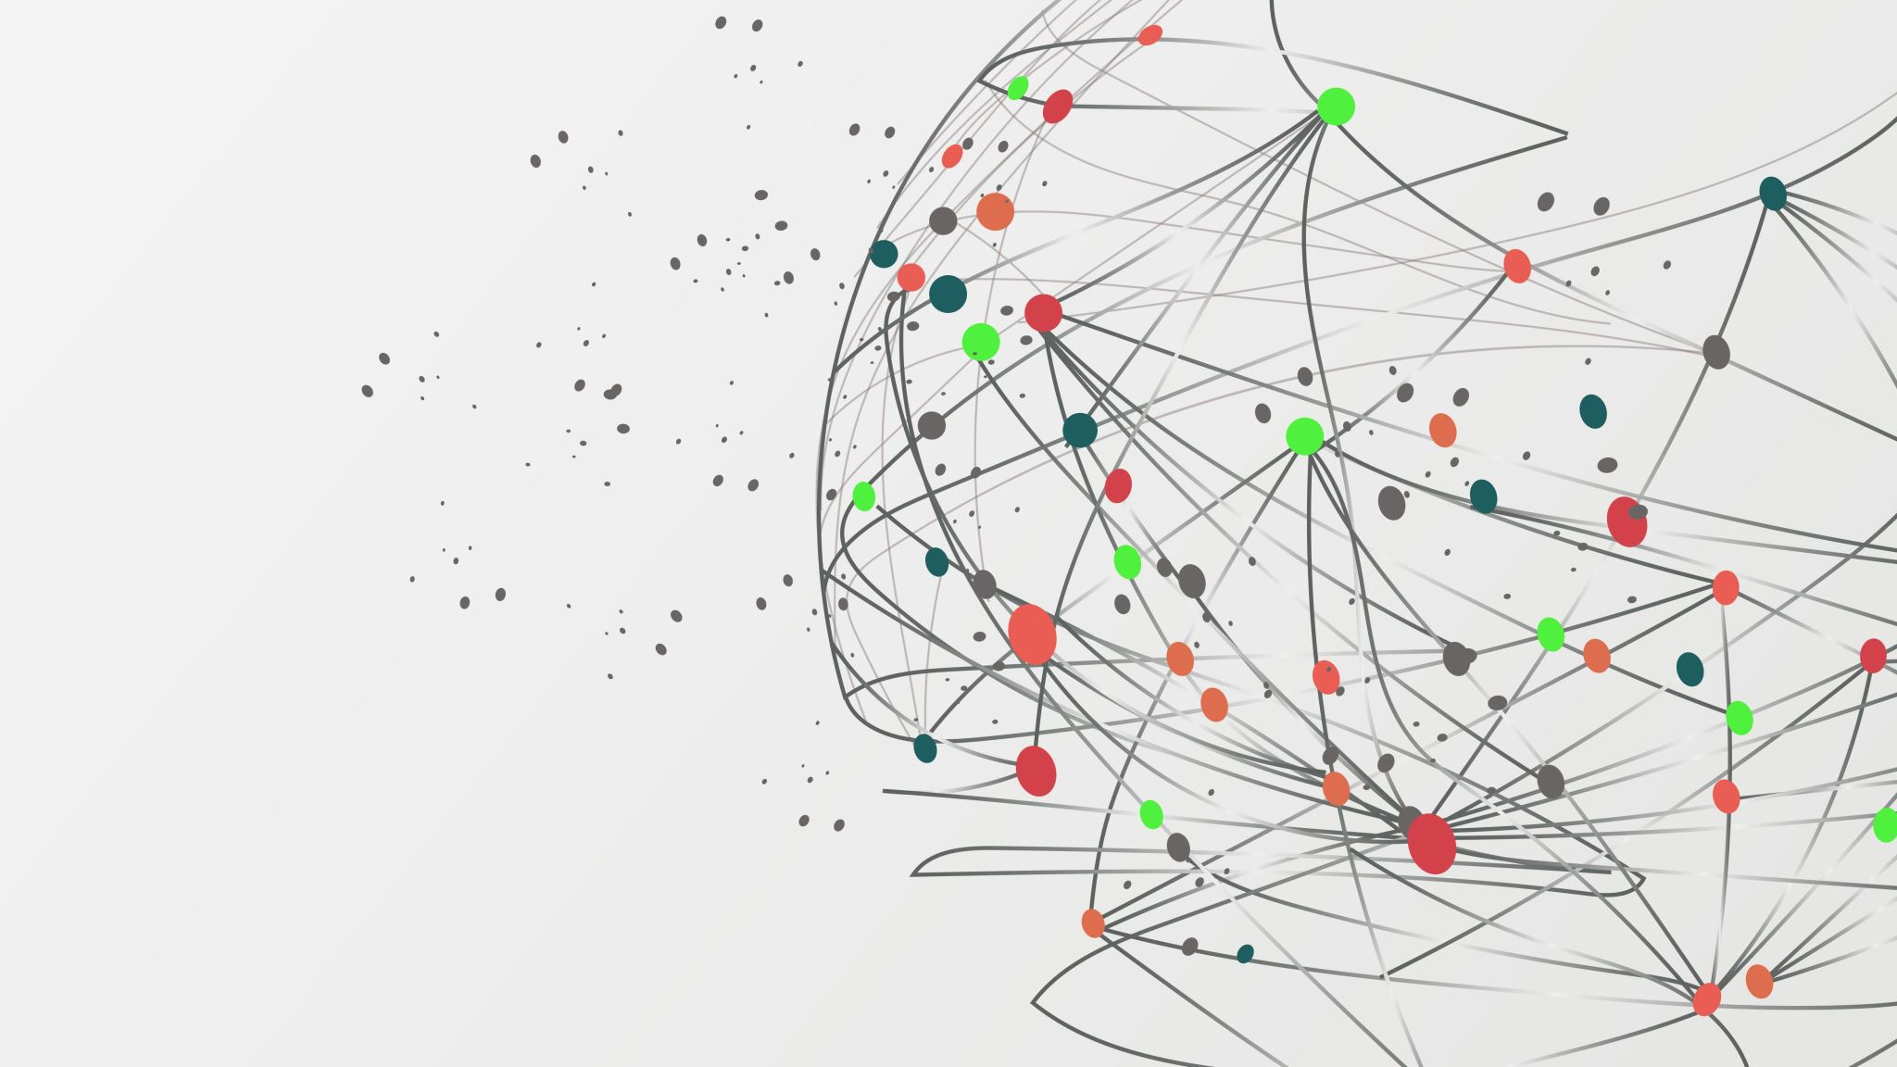
VGG Neural Nets
By: nick pierce

Slide 2
Why do we need neural networks?
ANNs can learn and show non-linear and complex connections, which is significant on the grounds that, all things considered, huge numbers of the connections among data sources and yields are non-direct.
ANNs can generalize — After learning from the initial inputs and their relationships, the model can generalize and predict on new data.
Unlike many other prediction techniques, ANN does not impose any restrictions on the input. Its ability to learn hidden relationships in the data without fixing the input data. This is something very useful in financial time series forecasting.

Slide 3
Applications
-image recognition
-computer vision
-speech and character recognition
-named entity recognition
-language generation

Slide 4
Imagenet
Researchers at the time wanted algorithms that could work with any kind of data, but there were some that took another approach.
Created By Fei-Fei Li a professor at the University of Illinois Urbana Champaign
Simply a giant dataset of images of all kinds cats, dogs, buildings, etc. and a label assigned to each
1.2 million training images with another 50,000 images for validation and 100,000 images for testing
Imagenet was so robust that it became the benchmark for every computer vision/object recognition architecture

Slide 5
Development of faster and more accurate CNN's
LeNet-5 – one of the first cnn models, possesses 7 layers 3 convolutional, 2 pooling, 1 fully connected, and one output layer
Alexnet – 8 layers 5 convolution and three fully connected layers. Utilized rectified linear units to increase training speed. Utilized multiple gpu’s as well. Easily won imagenet large-scale visual recognition challenge in 2012.
ZFNet – optimized version of alexnet with double the number of filters in conv layers and reduced filter size from 11x11 to 7x7 which resulted in fewer dead features
Inception – 27 layers deep decided to go deep instead of wide, was the winner of the imagenet recognition challenge in 2014

Slide 6
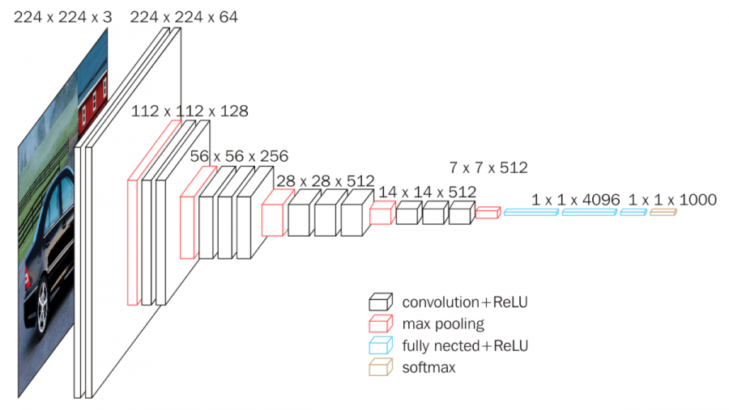
VGG Architecture

Slide 7
Data
For image recognition, data (images) can be of any size for the network, but research papers have standardized input to a fixed size 224 * 224 * 3
Next, images are rescaled and cropped
Images then have their mean rgb values subtracted from their pixels. This operation “centers” our data and helps to optimize the data set when passed through the weights and biases of the network
Data is finally augmented to increase data volume for training, the cropped images will be flipping horizontally and shifted by random rgb values

Slide 8
Convolution Layer Architecture

Slide 9
ReLU Unit Architecture
Rectified linear units (ReLU) are a modern activation function used by modern neural networks
Computationally efficient — allows the network to converge very quickly
Non-linear— although it looks like a linear function, ReLU has a derivative function and allows for backpropagation
Non-linear functions address the problems of a linear activation function:
They allow backpropagation because they have a derivative function which is related to the inputs
They allow “stacking” of multiple layers of neurons to create a deep neural network. Multiple hidden layers of neurons are needed to learn complex data sets with high levels of accuracy.

Slide 10
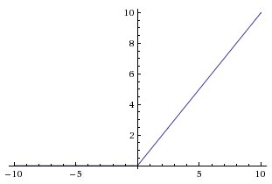
F(x) = max(0, x)
The function returns 0 if it receives a negative input, any positive input x will return x

Slide 11
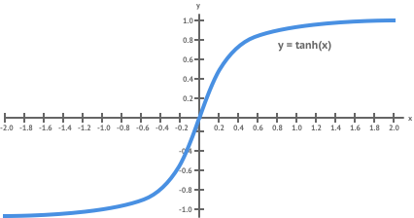
ReLu Vs Tanh function
The ReLU function has a derivative of 0 over half it's range For positive inputs, the derivative is 1
When training on a sizable data set, there will be some data points giving positive values to any given node. So the average derivative is rarely close to 0, which allows gradient descent to keep progressing
However researchers had difficulty building deep models when using the tanh function. It is relatively flat except for a very narrow range. The derivative of the function is very small unless the input is in this narrow range, and this flat derivative makes it difficult to improve the weights through gradient descent. This problem gets worse as the model has more layers. This was called the vanishing gradient problem.

Slide 12
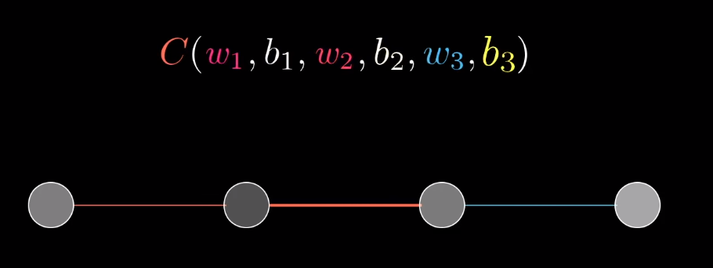
Backpropogation

Slide 13
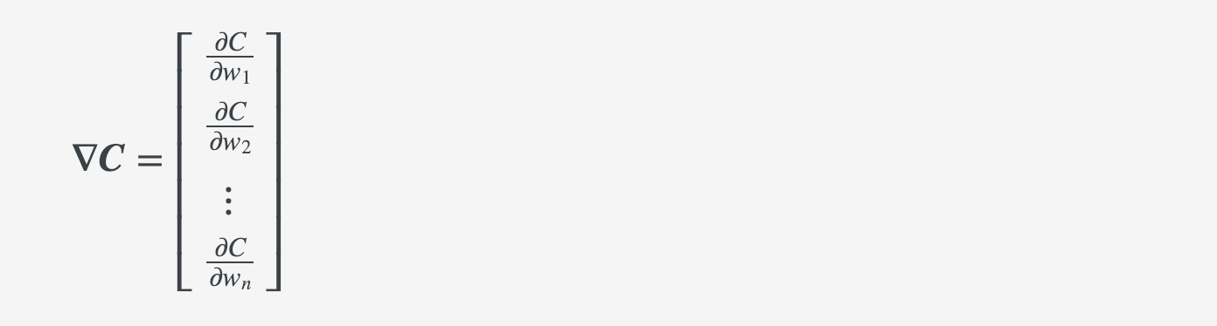
Gradient Descent
The negative gradient -∇f will point in the direction where the function decreases most rapidly (aka maximum descent). This fact we can use to calculate new weights W⁺ from our current weights W:
This will tell us how much the cost function changes when the weights change and we’ll use this information to reduce the cost function as much as possible to approach some kind of pre determined goal

Slide 14
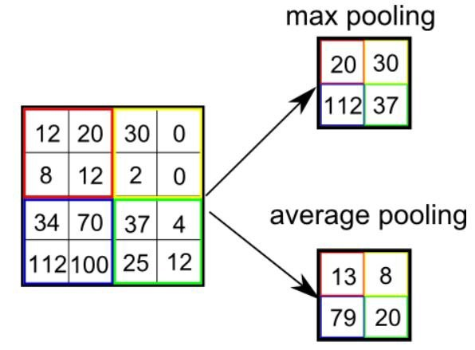
Max Pooling Architecture
Each convolution operation will output a unique feature map
What do we do when the convolution layers output several feature maps that are nearly or even identical?
Pooling decreases the dimensionality of the feature sets by displaying the dominant features that were uncovered by the convolution operation

Slide 15
Fully Connected Layer
The fully connected layer flattens the results of the previous pooling/convolution into a single vector of values. This vector is the probability that certain features belong to a label.
For example, an image feature may be whiskers, this should have high probabilities for the label “cat”.

Slide 16
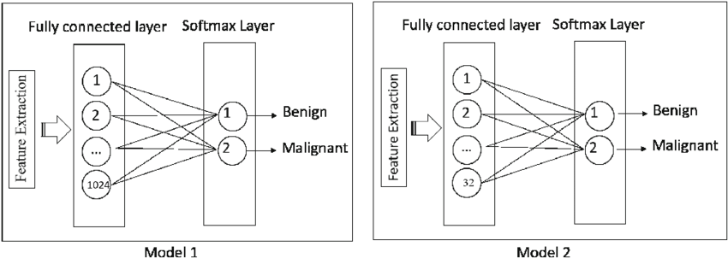
Softmax Layer

Slide 17
Main VGG Differences
Instead of using large receptive fields (areas where the neuron covers the image) like AlexNet (11x11 with a stride of 4), VGG uses very small receptive fields (3x3 with a stride of 1). Because there are now three ReLU units instead of just one, the decision function is more susceptible to not activating. There are also fewer parameters (27 times the number of channels compared to that of AlexNet’s 49 times the number of channels).
VGG utilizes 1x1 convolutional layers to make the decision function more non-linear without changing the receptive neurons.
The small-size convolution filters allows VGG to have a large number of weight layers. GoogLeNet, another model that uses deep CNNs and small convolution filters, was also showed up in the 2014 ImageNet competition.
In contrast to VGG-16, AlexNet retains more unrelated background information in last convolutional layer, which throws off the final prediction, thus the VGG predicts better than AlexNet.

Slide 18
Drawbacks to VGG
It is very hard to train being fairly deep
The architecture is very large roughly 533 mb making it hard to deploy for practical purposes

Slide 19
Sources
https://towardsdatascience.com/a-comprehensive-guide-to-convolutional-neural-networks-the-eli5-way-3bd2b1164a53
http://www.robots.ox.ac.uk/~vgg/practicals/cnn/index.html
https://arxiv.org/pdf/1409.4842.pdf
https://medium.com/@pechyonkin/key-deep-learning-architectures-lenet-5-6fc3c59e6f4

